Slide 2

Purpose and justification
EO technologies to improve the monitoring of:
Atmosphere
Marine environment
Land
Climate change
Emergency management
Security
Objectives “Building a low-carbon, resilient future”
New technologies are needed

Slide 3
WP1: Project management
WP2: Quality and administration
WP6: Business planning and exploitation of results
WP7: Communication and dissemination strategies
Baseline for design
WP3: State of the art
New technologies requirements
Final designs
WP4: Product development
Test, performance and quality data
Product design
WP5: Simulation, testing, validation and quality

Slide 4
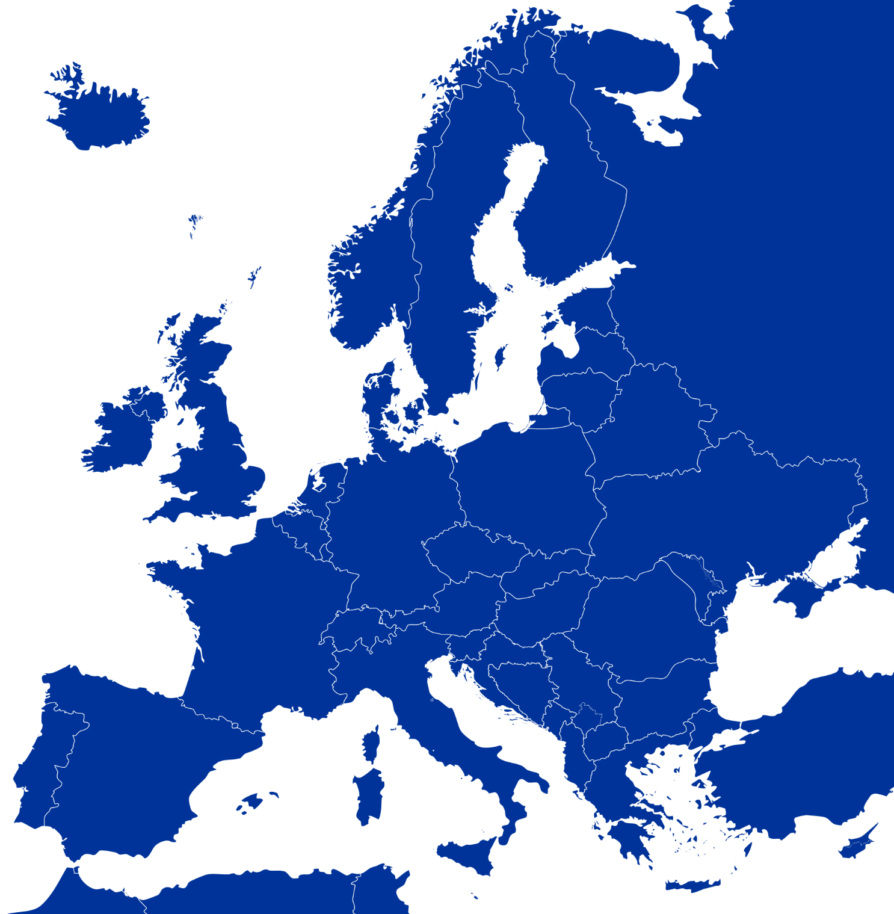








Project management, quality, business plan and explotation:
HIRO
BHO legal Rechtsanwälte
Partnership
Research in space technology and innovative design
HIRO
Airbus D&S
ICUBE-SERTIT
Development, testing and validation of space systems
Airbus D&S
Deimos Space
Thales Alenia Space
Urban development application
Vito
ReSAC

